Slide 1
Introduction to HTML – Hyper Text Markup Language
Instructor: Manu Peethambar
E-mail: cm13055@umbc.edu
Telegram handle: @manupeethambar888
Slides: https://github.com/manupeethambar888/webdev

Slide 2
Before we get started
UMBC ID: username@umbc.edu – Required! – If you still do not have your individual id and password, ask Mr. Moore / Mr. J.
Write down your name and GitHub username next to it on the sheet provided.
Programming needs practice everyday.
Class participation is the key and awarded with extra points for your assignments / homework.
Discipline – No Phones, no talking to each other, ask a question to the instructor with permission.

Slide 3
Web Development Introduction
https://youtu.be/jHPr-CuvHhs
Previous class assignment: Commit your changes and push the changes to master branch of your repository.

Slide 4
HTML – Hyper Text Markup Language
HTML is the standard markup language for creating Web pages.
HTML describes the structure of Web pages using markup.
HTML elements are the building blocks of HTML pages.
HTML elements are represented by tags.
HTML tags label pieces of content such as "heading", "paragraph", "table", and so on.
Browsers do not display the HTML tags, but use them to render the content of the page.

Slide 5
Assignment 1 explained
The <!DOCTYPE html> declaration defines this document to be HTML5
The <html> element is the root element of an HTML page
The <head> element contains meta information about the document
The <title> element specifies a title for the document
The <body> element contains the visible page content
The <h1> element defines a large heading
The <p> element defines a paragraph
https://www.khanacademy.org/computing/computer-programming/html-css/intro-to-html/p/html-basics

Slide 6
HTML Tags
HTML tags are element names surrounded by angle brackets.
<tagname>content goes here...</tagname>
Web Browsers
The purpose of a web browser (Chrome, IE, Firefox, Safari) is to read HTML documents and display them.
The browser does not display the HTML tags, but uses them to determine how to display the document.

Slide 7
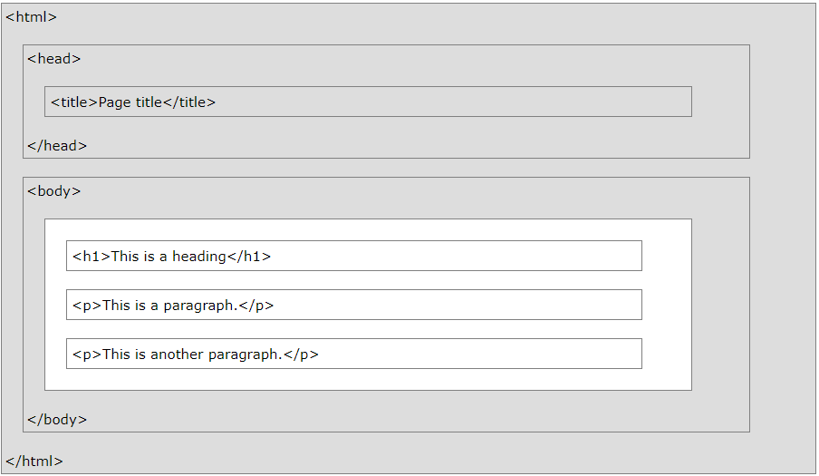
HTML Page Structure

Slide 8
The <!DOCTYPE> Declaration
The <!DOCTYPE> declaration represents the document type, and helps browsers to display web pages correctly.
It must only appear once, at the top of the page (before any HTML tags).
The <!DOCTYPE> declaration is not case sensitive.
The <!DOCTYPE> declaration for HTML5 is: <!DOCTYPE html>

Slide 9
HTML Links
HTML links are defined with the <a> tag.
<a href="https://www.umbc.edu">Welcome to UMBC</a>
HTML Images
HTML images are defined with the <img> tag.
<img src=“umbc.jpg" alt=“umbc_logo" width="104" height="142">

Slide 10
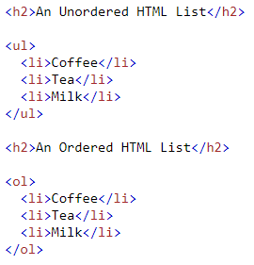
HTML Buttons
HTML buttons are defined with the <button> tag.
<button>Click me</button>
HTML Lists
HTML lists are defined with the <ul> (unordered/bullet list) or the <ol> (ordered/numbered list) tag, followed by <li> tags (list items).

Slide 11
HTML Attributes
All HTML elements can have attributes
Attributes provide additional information about an element
Attributes are always specified in the start tag
Attributes usually come in name/value pairs like: name="value"
The href Attribute
The src Attribute
The width and height Attributes
The alt Attribute
The style Attribute
The title Attribute

Slide 12
Assignment 2 due – 6/27/2018.
Create a sample html file:
Add a tooltip to a sample paragraph with the text “I am a tooltip".
Change the size of the umbc logo to 250 pixels wide and 400 pixels tall.
Transform the text below into a link that goes to "https://www.google.com".
The image below does not exist. Specify the alternate text "w3schools.com" for the image.
<img src=“xyz.jpg" width="100" height="50">
Save this as “assignment2.html” and in your repository “Assignments_yourname”.
Commit and push the changes to the repository.

